Slide 1
Swin
Transformer
Block
Swin
Transformer
Block
Swin
Transformer
Block
Swin
Transformer
Block
Images
Patch Partition
Linear Embedding
Patch Merging
Patch Merging
Patch Merging
X2
X2
X6
X2

Slide 2
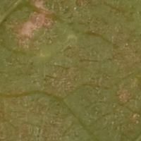
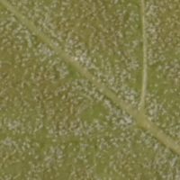
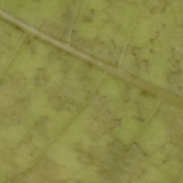
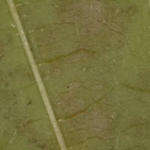
z1
0.5
Backbone
P(r > 0)
z2
P(r > 1)
z3
P(r > 2)
z4
P(r > 3)

Slide 3
P(OIV = 1)
P(OIV = 3)
P(OIV = 5)
P(OIV = 7)
P(OIV = 9)

Slide 4
